Slide 1


Lesson 3 Teens and technology
UNIT 1

Slide 2
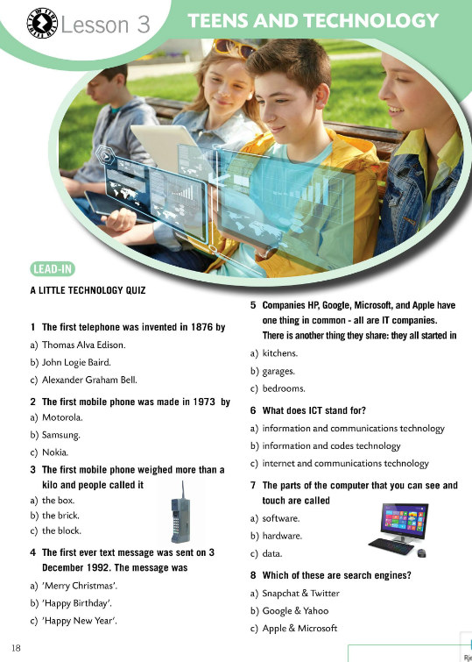
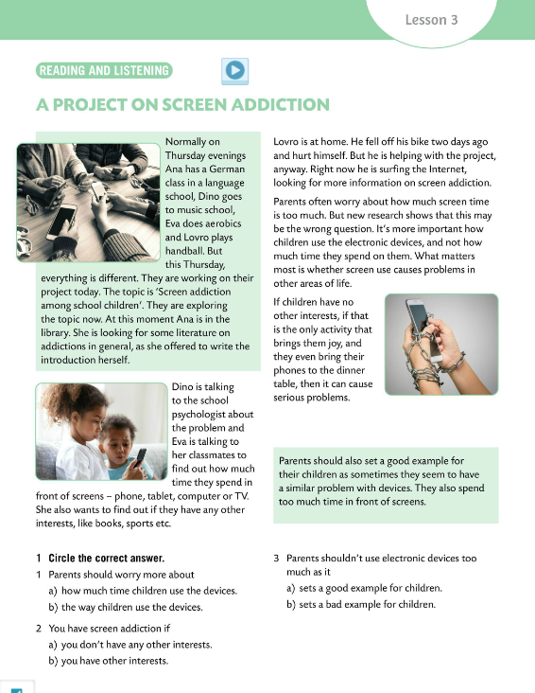
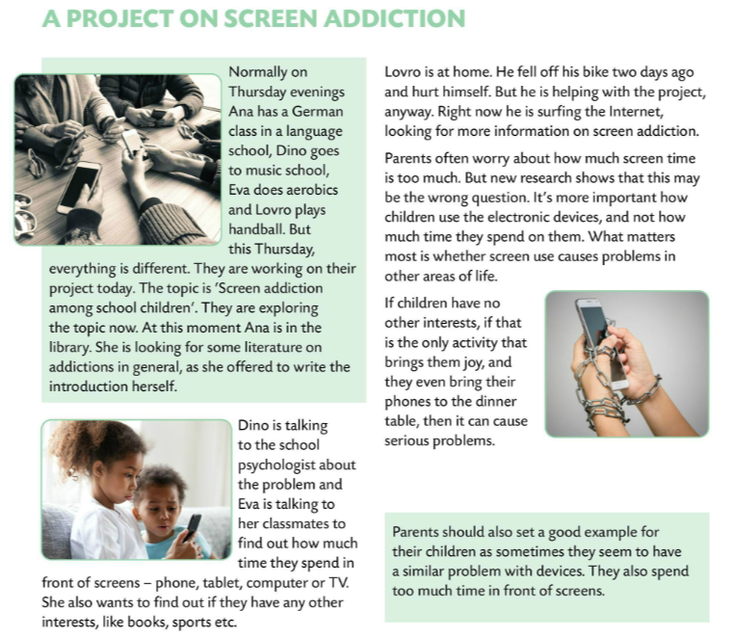
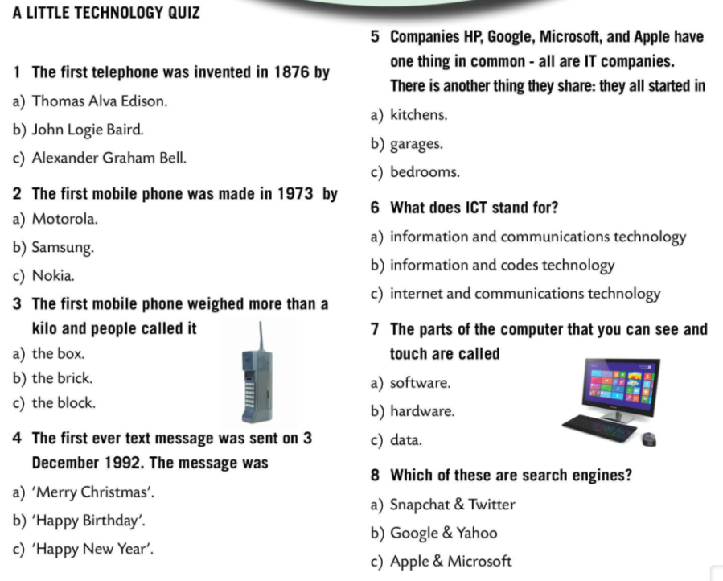

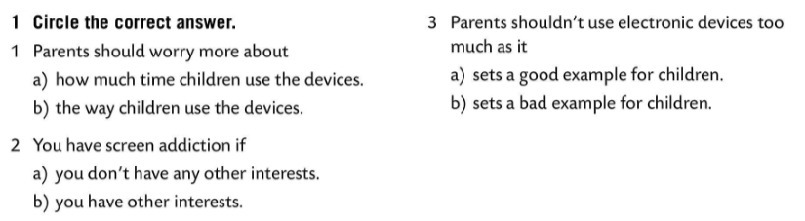
Are you tech-savvy? Find out how much do you know about technology in this little technology quiz.
Check.
Listen to the recording.
Read the text and circle the correct answer in Task 1.
Check.

Slide 3
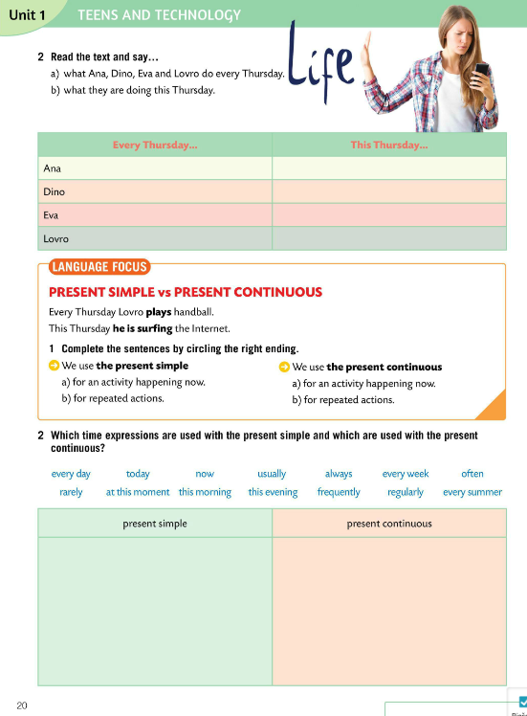
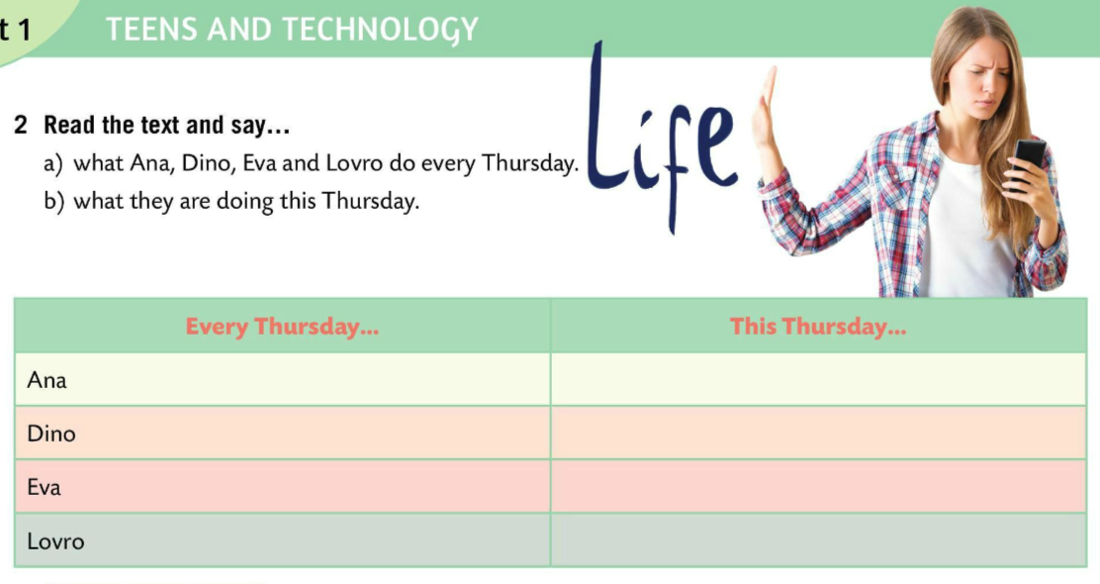
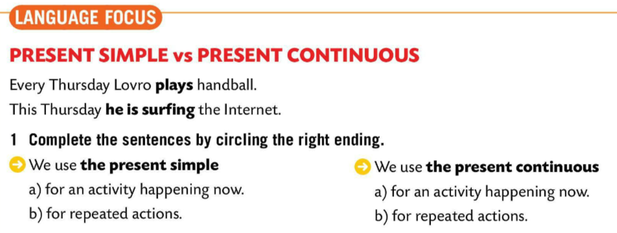
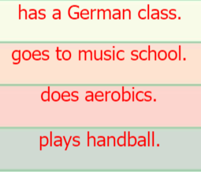
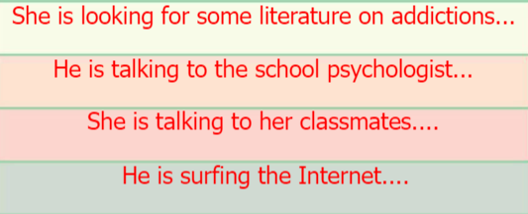
LANGUAGE FOCUS
Complete the sentences by circling the right letter.
Check.
We use the present simple for repeated actions and the present continuous for an activity happening right now.
Glagolsko vrijeme present simple koristimo za učestale radnje, a glagolsko vrijeme present continuous za radnju koja se događa sada – u trenutku u kojem govorimo.
Read the text and fill in the table in Task 2.

Slide 4
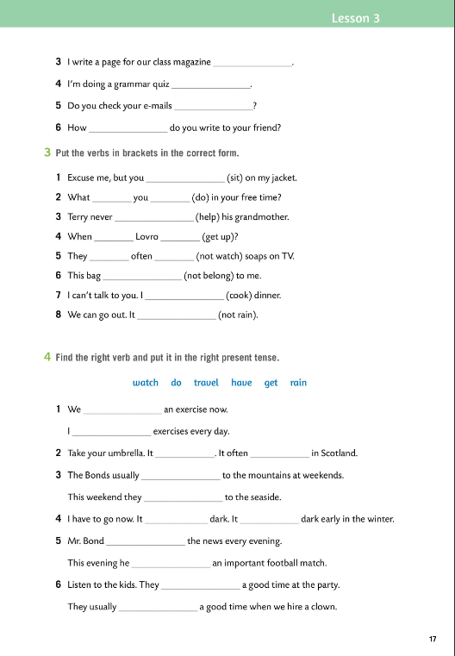

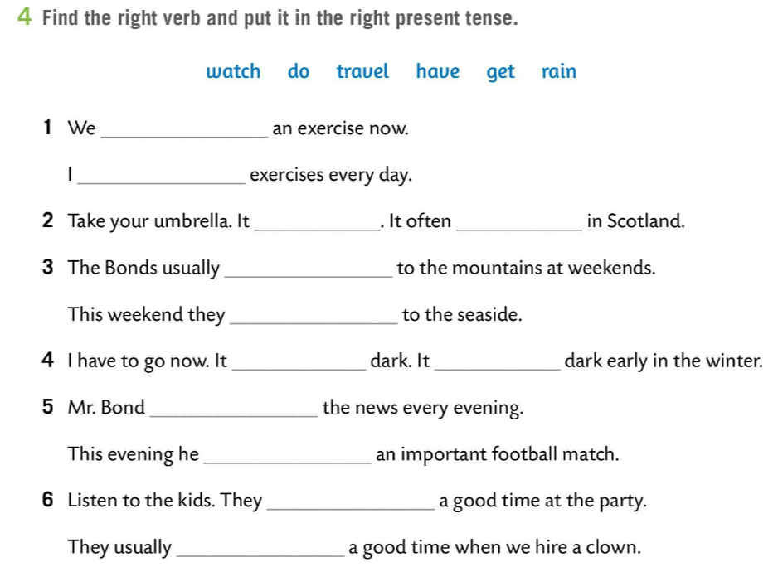
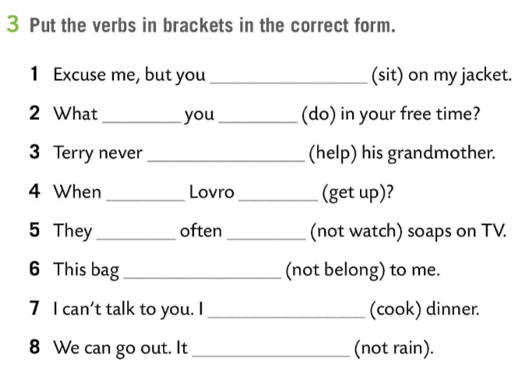
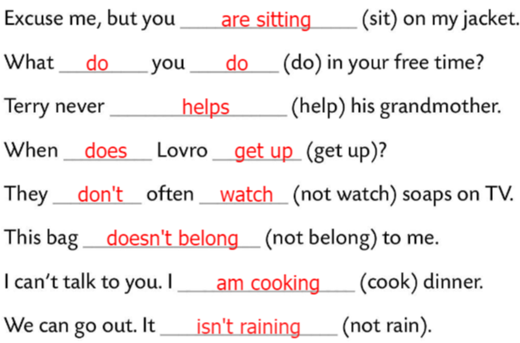
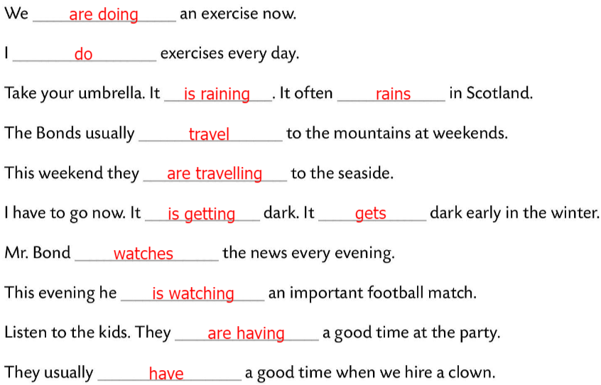
Workbook, page 17
Put the verbs in brackets in the correct form.
Check.
Find the right verb and put it in the right present tense.
Check.

Slide 5
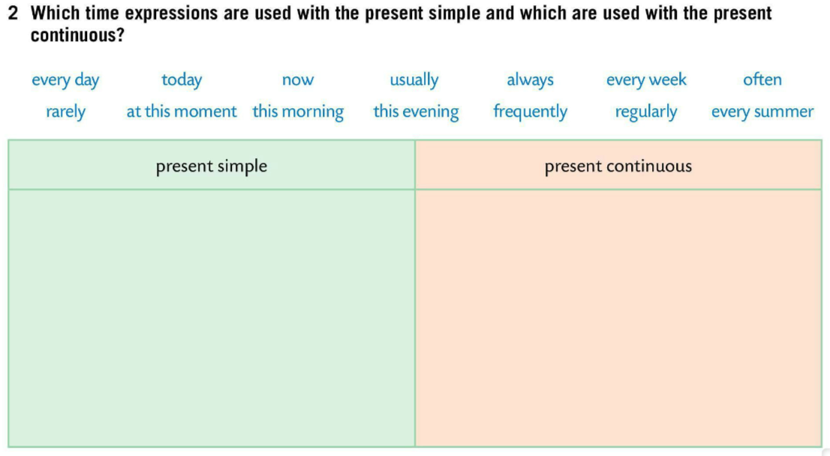
Which time expressions are used with the present simple and which are used with the present continuous?
Check.
Make at least four sentences using these time expressions.
every day, usually, always, often, every week, rarely, frequently, regularly, every summer
today, now, at this moment, this morning, this evening
Drag and drop the time expressions into their their group.
https://wordwall.net/play/843/402/396

Slide 6
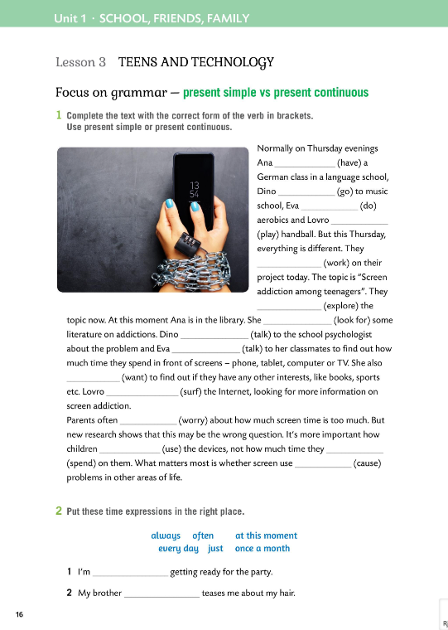
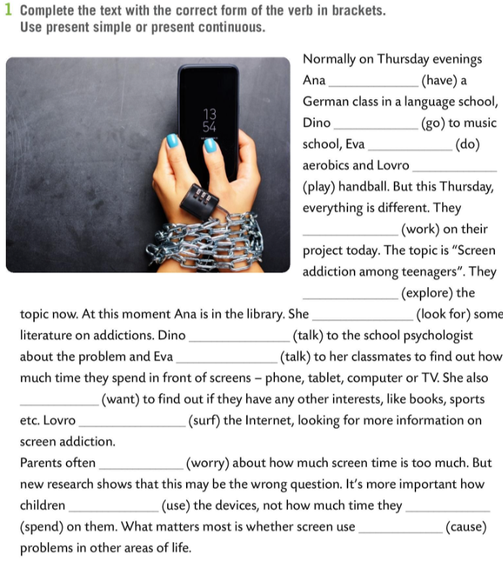
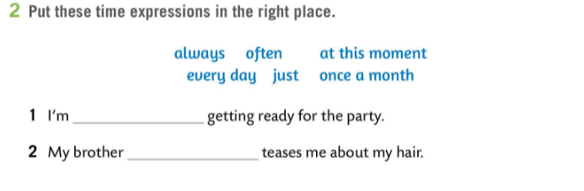
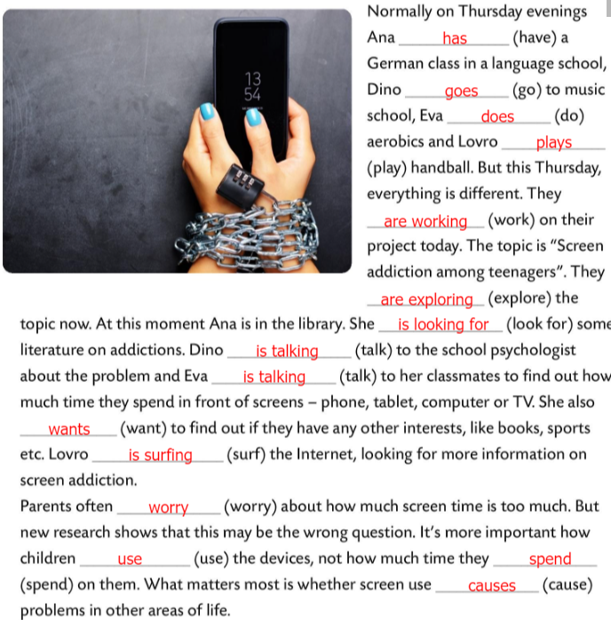

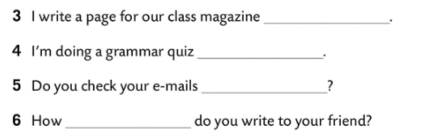
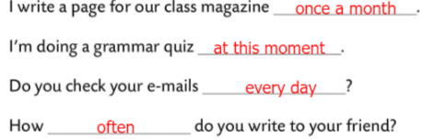
Workbook, page 16
Complete the text with the correct form of the verb in brackets.
Use present simple or present continuous.
Check.
Put the time expressions in the right place.
Check.

Slide 7
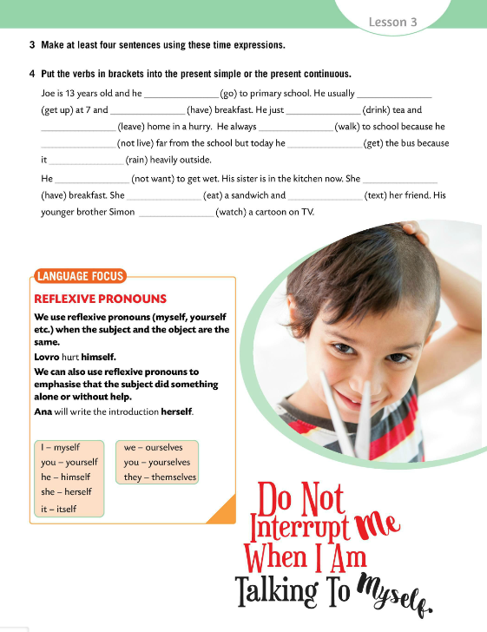
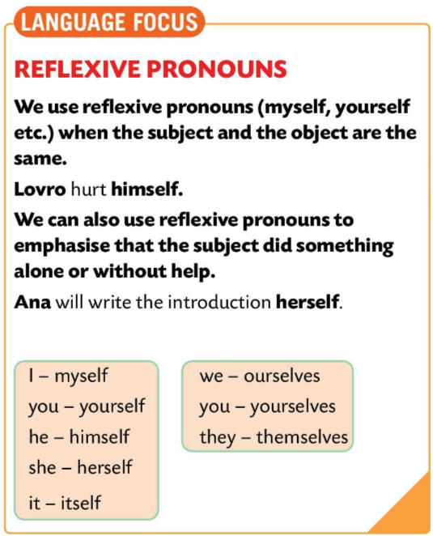
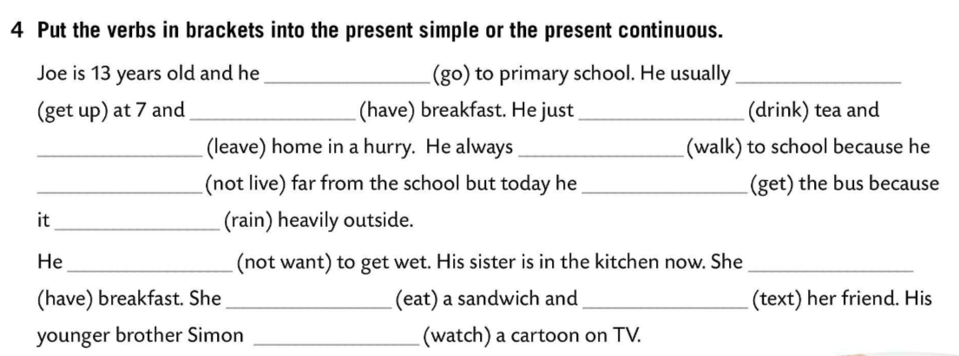
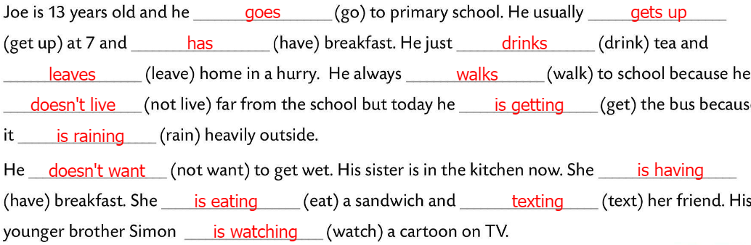
Play the game!
Choose the correct form of the verb.
https://learningapps.org/watch?v=px7xroxc520
Put the verbs in brackets into the present simple or the present continuous.
Check.
LANGUAGE FOCUS
We use reflexive pronouns (myself, yourself etc.) when the subject and the object are the same.
Povratne zamjenice koristimo kada su subjekt i objekt u rečenice isti.
Lovro hurt himself.

Slide 8
We can also use reflexive pronouns to emphasise that the subject did something alone or without help.
Povratne zamjenice koristimo kada želimo naglasiti kako je subjekt rečenice nešto učinio samostalno to jest bez ičije pomoći.
I did it myself.
Ana will write the introduction herself.
Copy the rules and examples.
Play the game! ☺ https://wordwall.net/play/843/471/713

Slide 9
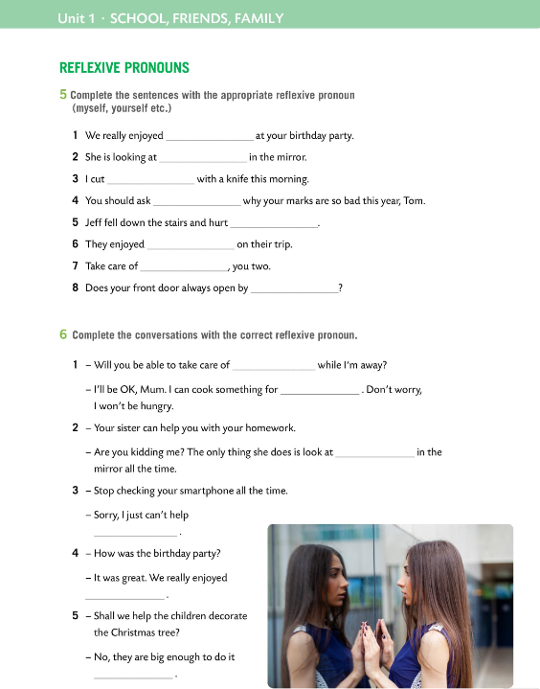
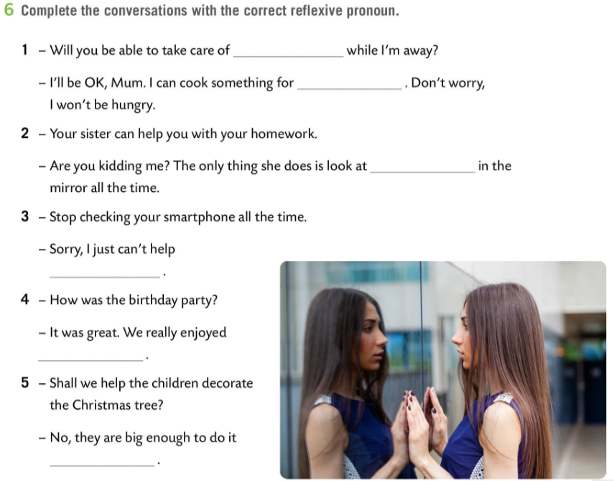
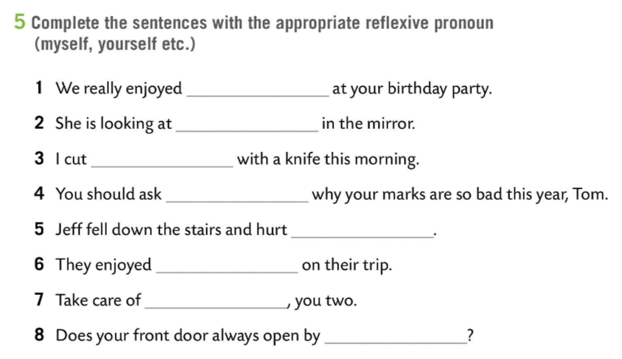
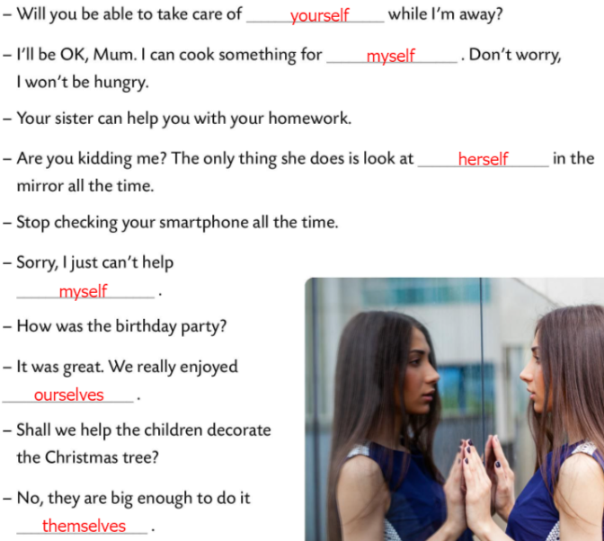
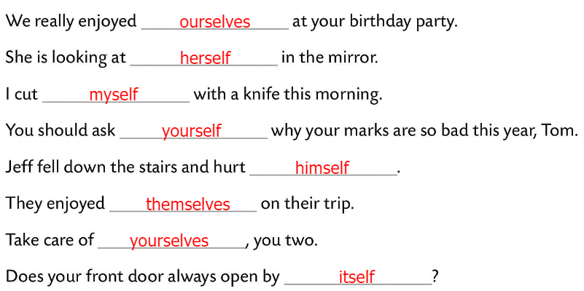
Workbook, page 18
Put the verbs in brackets in the correct form.
Check.
Complete the conversations with the correct reflexive pronoun.
Check.

Slide 10
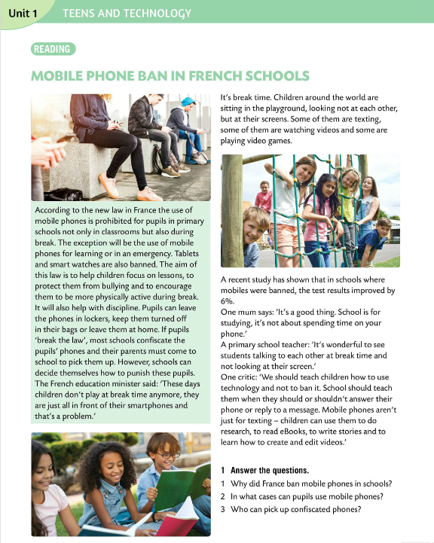
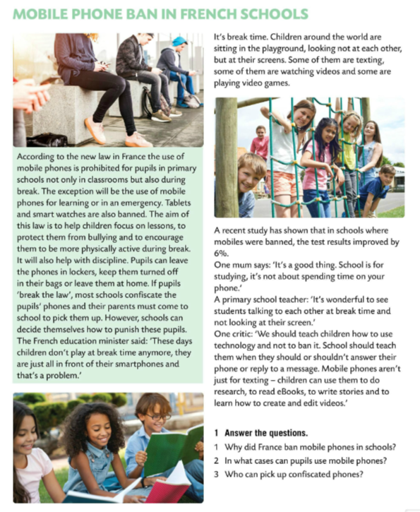
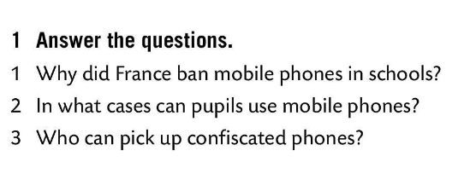
Read the text and underline the new words.
Translate the words.
Read the text once again and answer the questions.
Check.
1 To help children focus on lessons, to protect them from bullying and to encourage them to be more physically active.
2 Pupils can use mobile phones for learning or in an emergency.
3 Their parents can pick up the phones.

Slide 11
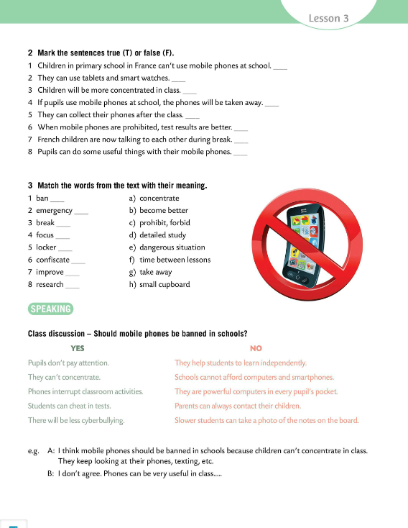
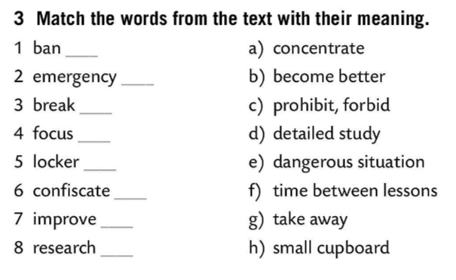
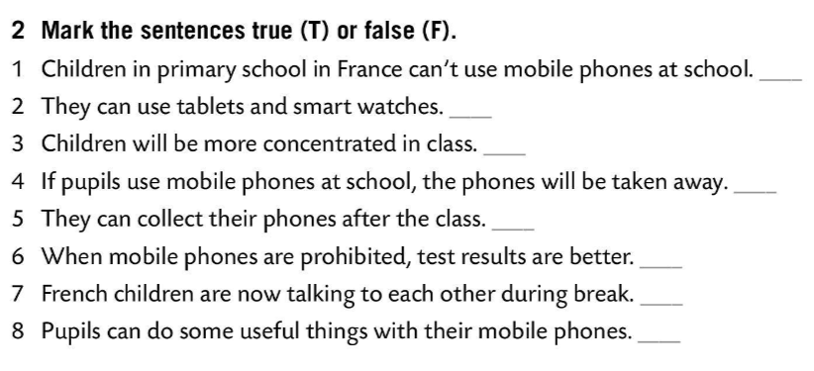
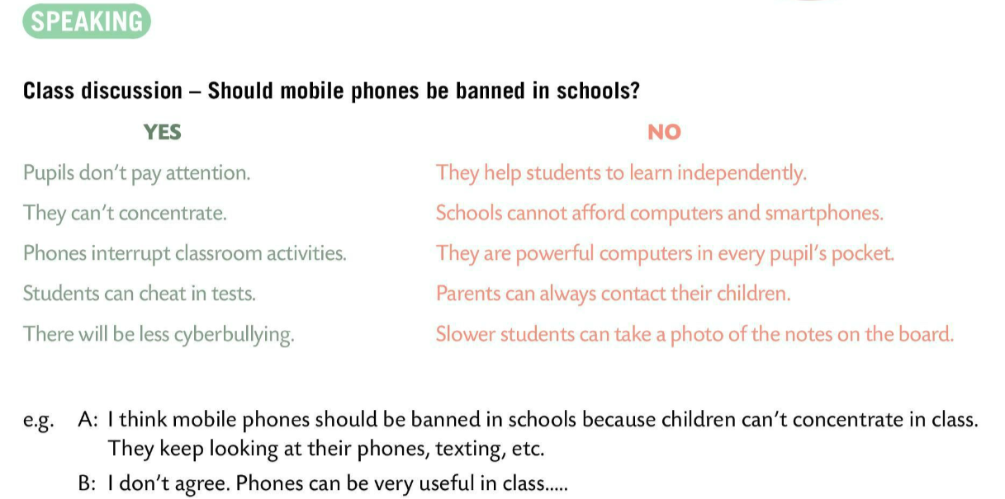
Make the sentences true (T) or false (F).
Check.
Match the words from the text with their meaning.
c)
T
e)
F
f)
T
Check.
T
a)
F
h)
T
Speaking time!
Have a class discussion on the topic: ‘Should mobile phones be banned in schools?’
Read pros and cons of banning mobile phones. What do you think? Express your opinion.
Provide arguments.
g)
T
b)
T
d)

Slide 12
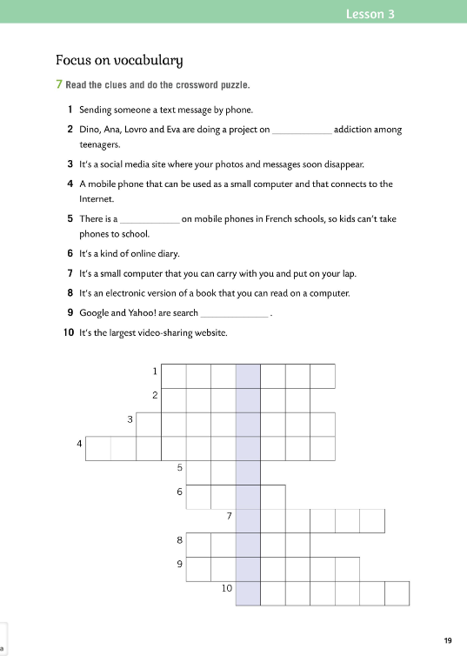
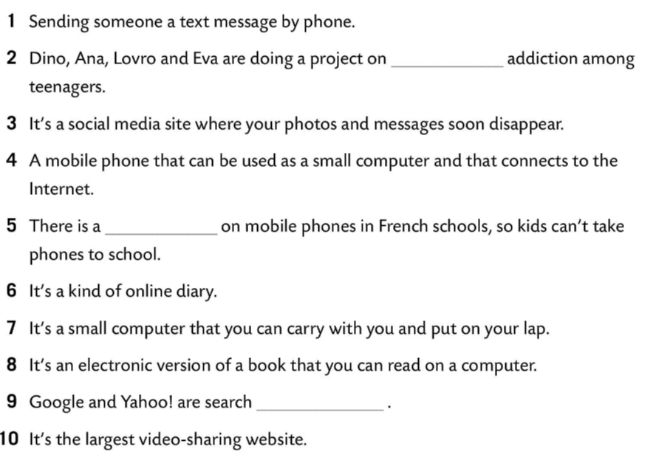
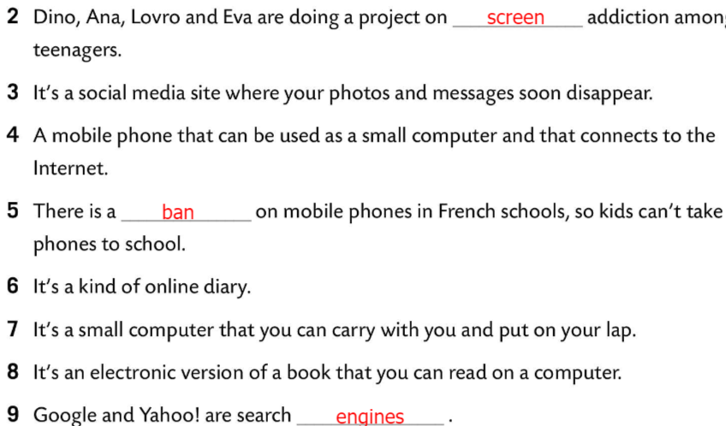
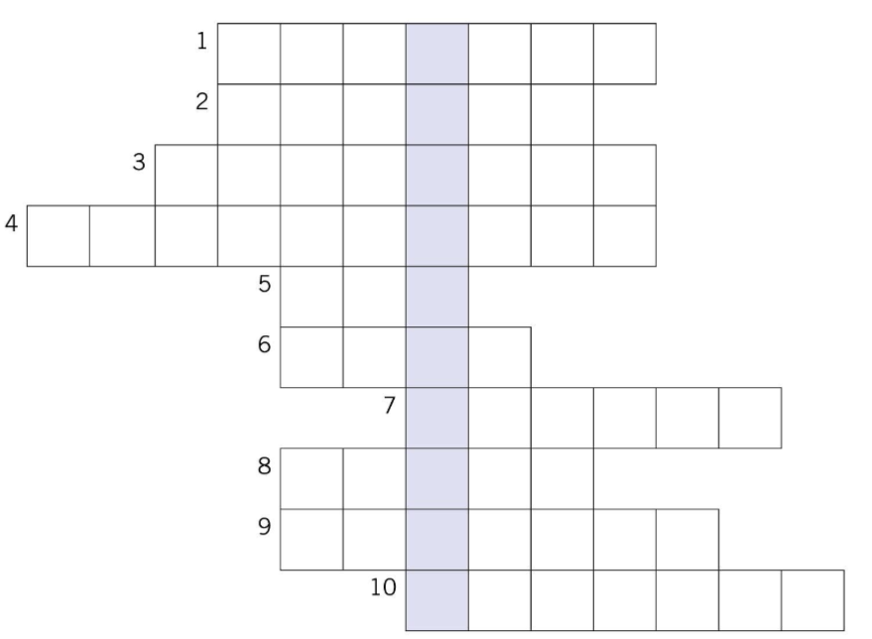
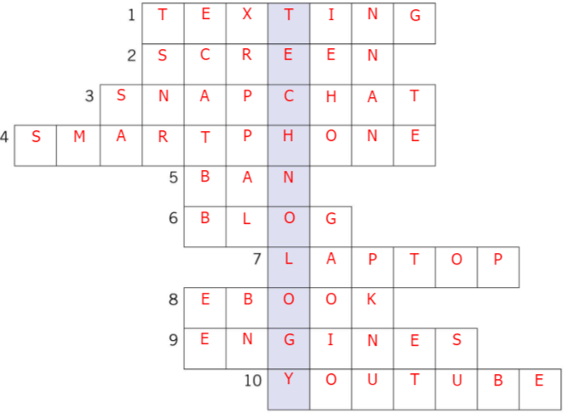
Workbook, page 19
Read the clues and do the crossword puzzle.
Check.

